Slide 1
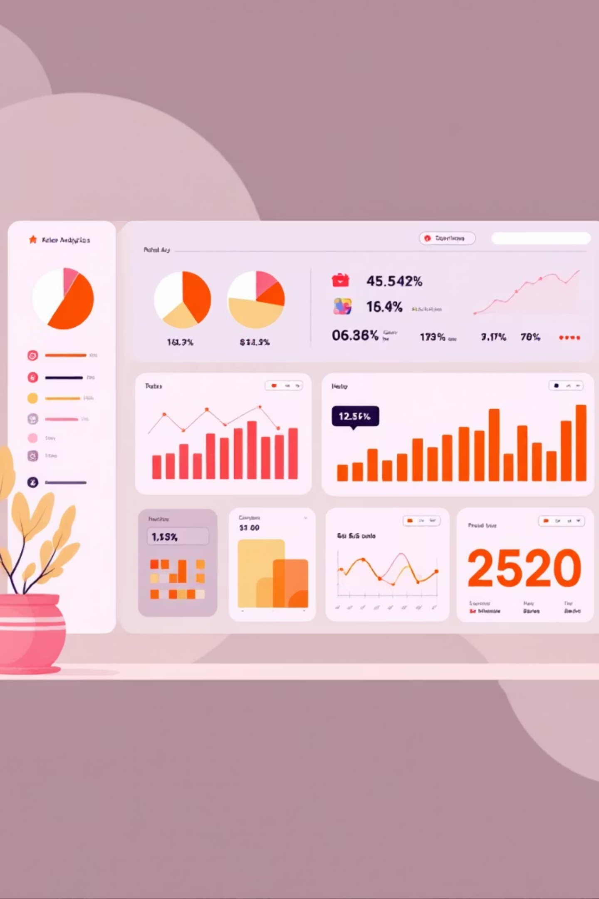
Customer Shopping Behavior Analysis
Exploring 3,900 transaction records to uncover spending trends, customer segments, and subscription patterns that drive data-driven business decisions.

Slide 2
Dataset Overview
3,900 Transactions
Customer Demographics
Comprehensive records across 18 key features
Age, gender, location, and subscription status
Purchase Details
Shopping Behavior
Items, categories, amounts, seasons, sizes, and colors
Discounts, promo codes, purchase frequency, ratings, and shipping
Missing data: 37 values in Review Rating column, filled using category-specific median ratings.

Slide 3





Data Preparation Process
Data Loading
Imported CSV file using pandas for analysis
Initial Exploration
Used df.info() and .describe() for summary statistics
Data Cleaning
Filled missing Review Ratings with category-specific medians
Feature Engineering
Created age_group and purchase_frequency_days columns
Database Integration
Connected to PostgreSQL for structured SQL analysis

Slide 4
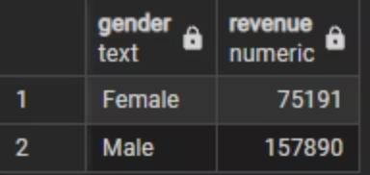
Revenue by Gender
$157K
Male Revenue
Significantly higher spending
Female
$75K
Male
Female Revenue
Opportunity for growth
Male customers generate more than double the revenue of female customers, indicating a key demographic for targeted marketing.

Slide 5
Product Performance Insights
Top 5 Products by Rating
Top 3 Products per Category
Highest-rated items drive customer satisfaction and repeat purchases
Most purchased items within each product category

Slide 6

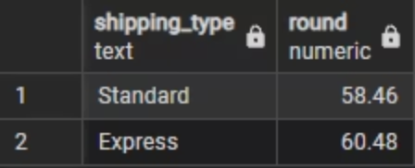
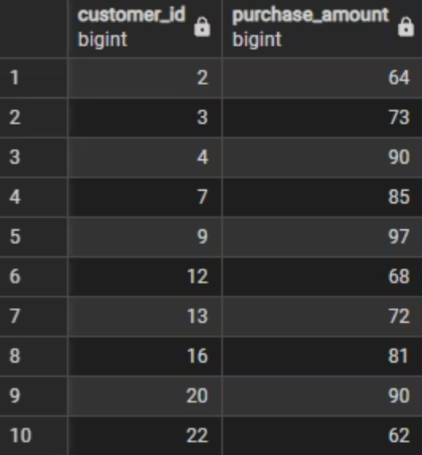
Discount & Shipping Analysis
High-Spending Discount Users
Shipping Type Comparison
Standard: $58.46 averageExpress: $60.48 average
Customers using discounts while maintaining above-average purchase amounts

Slide 7
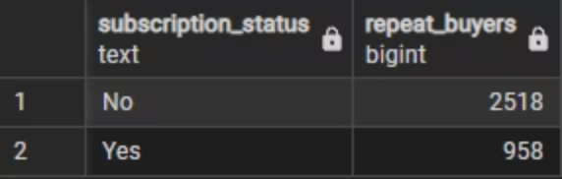
Subscription Impact
Subscribers vs Non-Subscribers
Repeat Buyers & Subscriptions
Comparison of average spend and total revenue across subscription status reveals significant differences in customer value.
958 subscribers with >5 purchases vs 2,518 non-subscribers

Slide 8

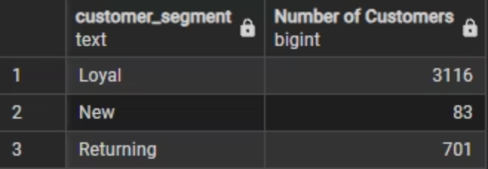
Customer Segmentation
1
Loyal
2
Returning
3
New Customers
Customers classified into three segments based on purchase history. Understanding these groups enables targeted retention and acquisition strategies.

Slide 9

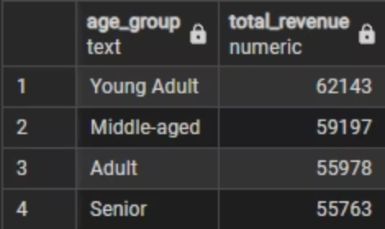
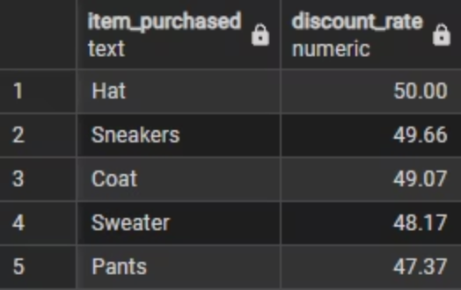
Revenue by Age Group & Discount Patterns
Total revenue contribution varies significantly across age demographics, revealing key target segments.
Five products with highest percentage of discounted purchases show discount dependency patterns.

Slide 10
Business Recommendations
Targeted Marketing
Strengthen Loyalty
Increase Subscriptions
Direct efforts toward high-spending age groups and customers who choose express delivery
Introduce or improve loyalty rewards to increase repeat purchases and grow loyal customer segments
Highlight unique perks and added value customers receive when they subscribe
Revisit Discount Strategy
Improve Product Visibility
Adjust discounts to support sales growth without reducing overall profit margins
Feature high-rated and best-selling items prominently in marketing and promotional campaigns

